Slide 1


Overview of ARTIC nCoV-2019 sequencing protocol
ARTIC Network Train the Trainer - August 2022
ARTIC TRAIN 02AUG22 Anna Kovalenko

Slide 2

ARTIC for Real-time COVID Genomic Surveillance !!!Before to start!!
Prepare for your experiment
You will need to:
Extract your RNA
Prepare Negative controls: minimum 2 – Extraction Neg Control and Neg Control at the RT step
always track and monitor cross-contamination using nuclease-free water and carrying these controls through the all library prep steps
Prepare pre-, post-PCR and clean hoods for handling samples and master mixes
Ensure you have the correct equipment, your sequencing kit and third-party reagents
Download the software for acquiring and analysing your data
Check your flow cell to ensure it has enough pores for a good sequencing run
!!!High Contamination Risk – Always use Neg Controls!!!
Notes:
To track and monitor cross-contamination, it is important to run a negative control at the reverse transcription step using nuclease-free water instead of sample, and carrying these controls through the all library steps.
It is important to clean and UV irradiate these hoods between sample batches and between each step of the protocol.

Slide 3








ARTIC for Real-time COVID Genomic Surveillance Sample Quality Control:
Good sample quality is important for robust sequencing results in your lab!
intact
degraded
get confidence in your results
minimize the time (i.e., not needed to repeat analyses)
optimize resources and budget
poor-quality results
waste time due to repeat analyses
waste lab resources and reagents
Notes:
Sample quality let you decide if your sample is up to your specifications before you invest your time and money on sequencing.
Important to start with good quality RNA samples.

Slide 4
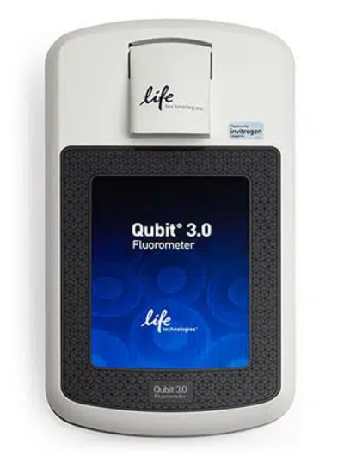
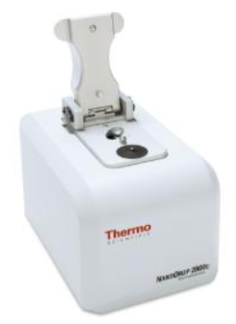
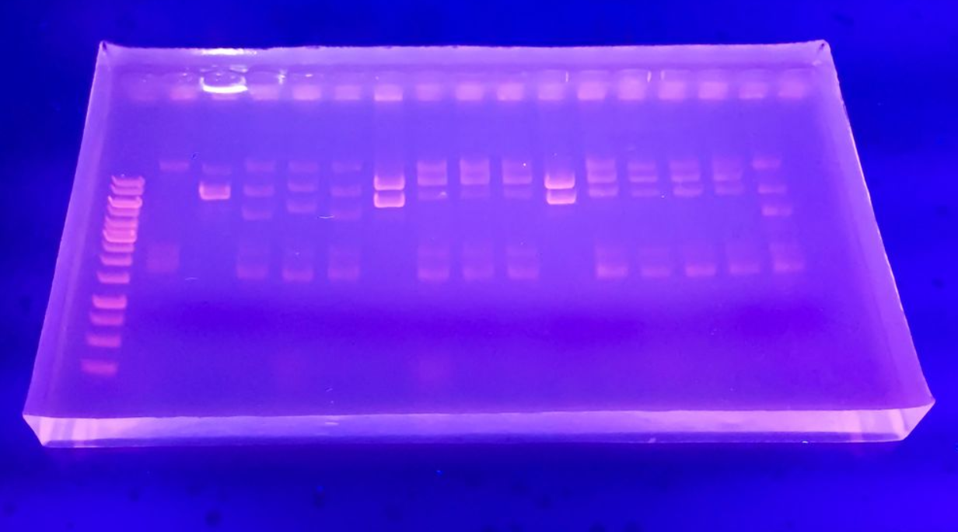
Sample quality metrics
ARTIC for Real-time COVID Genomic Surveillance Sample Quality Control:
Quality metrics available for your sequencing experiment:
Quantity:
Ct values (qPCR) measure the amount of a specific RNA target
post-PCR concentration with Qubit fluorometer (fluorescent dye-based quantification)
Purity:
analysis of nucleic acid purity with Nanodrop spectrophotometer
Size & Integrity:
gel electrophoresis
Agilent Bioanalyzer
prevent RNAse contamination! storage and handle your samples careful!

Slide 5


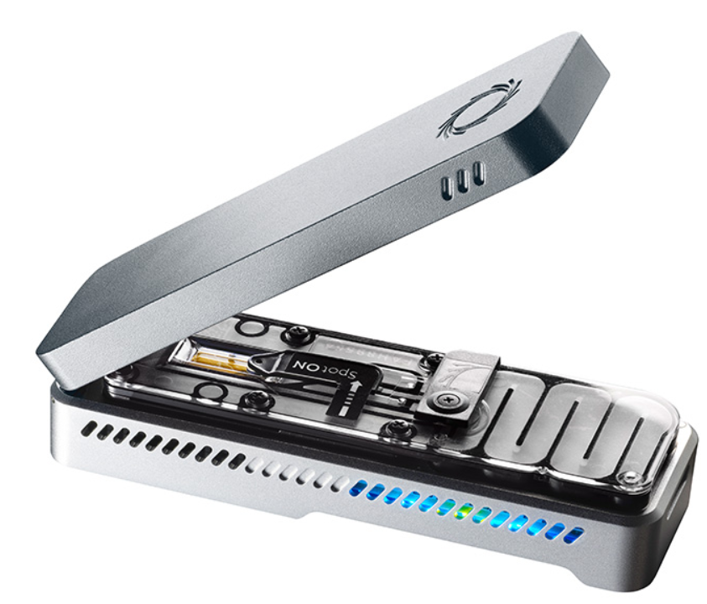



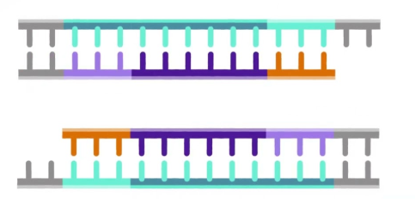


ARTIC for Real-time COVID Genomic Surveillance Sample Quality Control:
Check & Report the QC data on each step of your experiment!
Sequencing Workflow
Target Enrichment (RTPCR)
Samples
Data Analysis & Reporting
Testing Labs
Sequencing
fresh swabs
frozen swabs
frozen RNA
Library Preparation
Post PCR QC:
Qubit quantification (ng/ul)
gel if needs
Final Library Quality Assessment:
Qubit quantification (ng/ul)
QC your sequences:
contamination
clean Negatives
coverage
barcode efficiency
amplicon dropouts
Input Sample QC:
Ct values (qPCR)
Intermediate Library Quality Assessment:
Qubit quantification (ng/ul)
For robust results, you need to make sure your samples maintain integrity throughout the sequencing workflow!
Notes:
Good sample quality important not only at the beginning of your experiment but also throughout all sequencing workflow!

Slide 6
ARTIC for Real-time COVID Genomic Surveillance What are you going to sequence?
Ct - the criterion to help select which samples are good enough for sequencing
High Ct = Low genome coverage
Technical challenges – High Ct (>30) (low viral load or RNA degradation)!
samples (swabs/RNA) storage condition (extremely important)
Are you confident with this?
Notes:
This protocol requires total RNA extracted from samples that have been screened by qPCR.
Check what you are going to sequencing!!!
are you really confident with samples storage condition?
are you really confident that during sample transportation the proper temperature condition was applied?

Slide 7
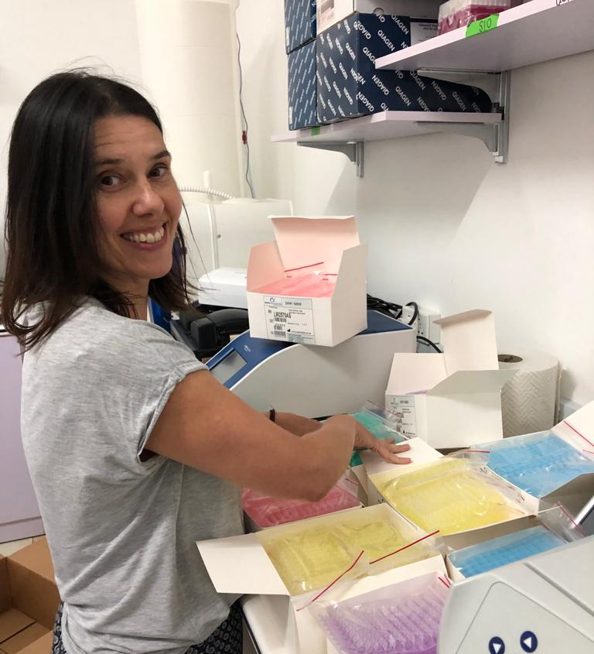

ARTIC for Real-time COVID Genomic Surveillance What are you going to sequence?
Ct values are reported by the test labs and could be overestimated, prior to additional sample handling!
RNA is extremely susceptible to degradation due to the ubiquitous presence of RNases in the environment! Great care and consideration is required when working with RNA!
Yaz Goodfellow – our gold Extraction hands/hero
Notes:
Ct values commonly are reported by the test provider, prior to additional sample handling
This is likely an overestimate of non-degraded viral RNA at the time of sequencing.
For this reason, great care and consideration is required when working with RNA.

Slide 8
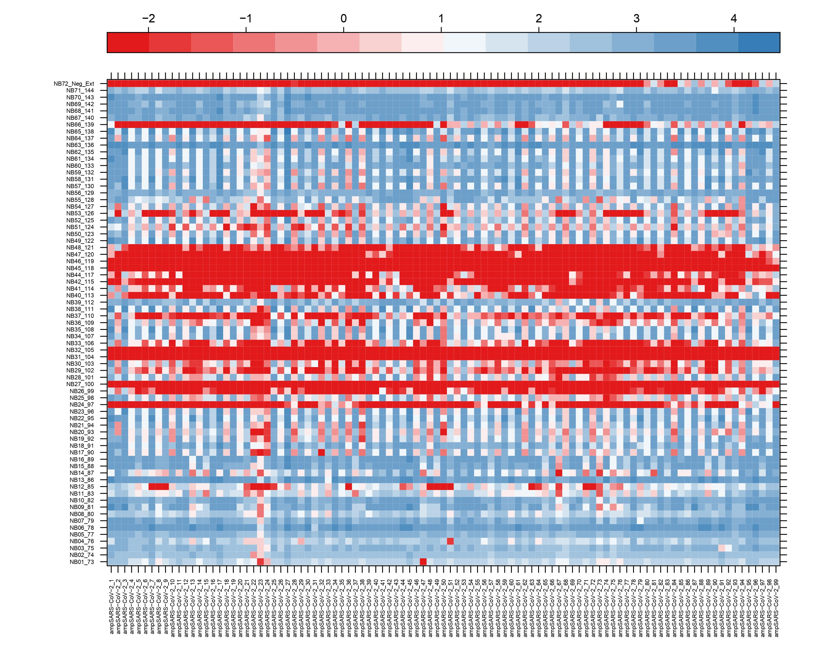
Sample degradation!
unappropriated storage condition
Total 71 samples
of which 21 with less than 50% genome coverage
Ct was less than 30 (between 20 - 28) (provided by diagnostic lab)
New RNA extraction before sequencing
Sample type: nasopharyngeal swabs
In total 99 amplicons (400bp size) to cover the whole SARS-C0V-2 genome
Notes:
coming back to..
x axis below correspond to each amplicon number

Slide 9
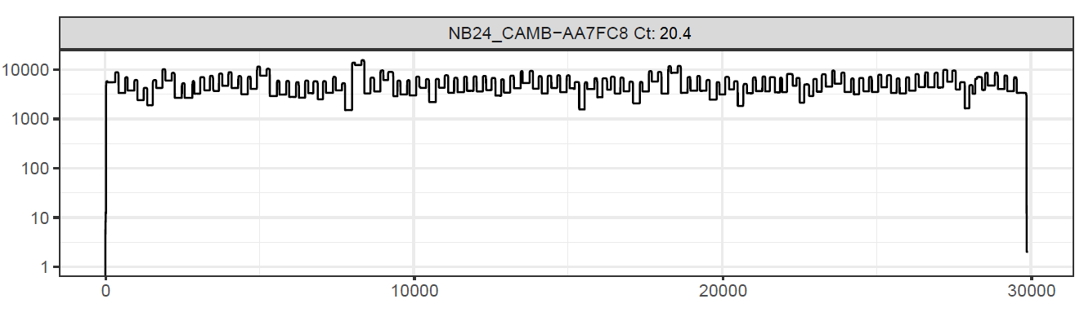
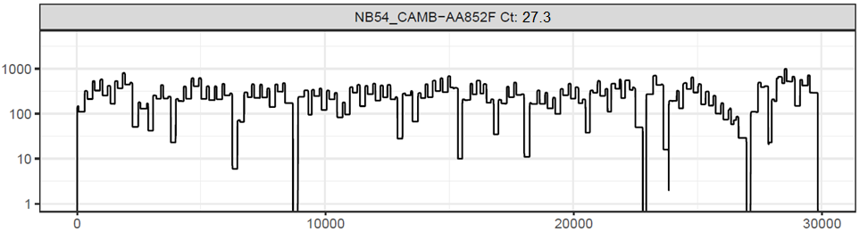
If you are confident with your samples and Ct Genome Coverage vs Ct
Low Ct sample – ideal coverage profile:
100% genome coverage
Moderate Ct sample – some amplicon dropouts:
93% genome coverage
Notes:
If you are confident with your samples and Ct

Slide 10
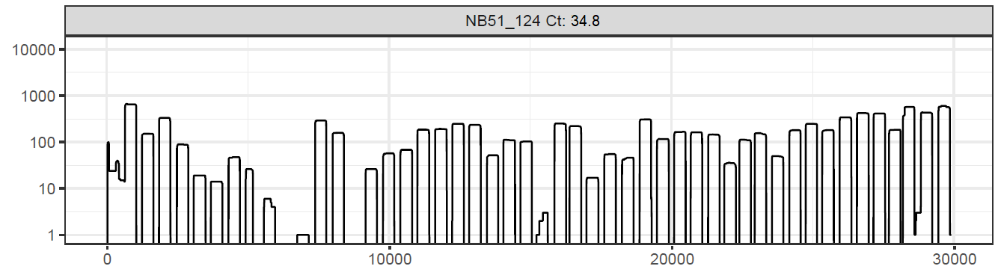
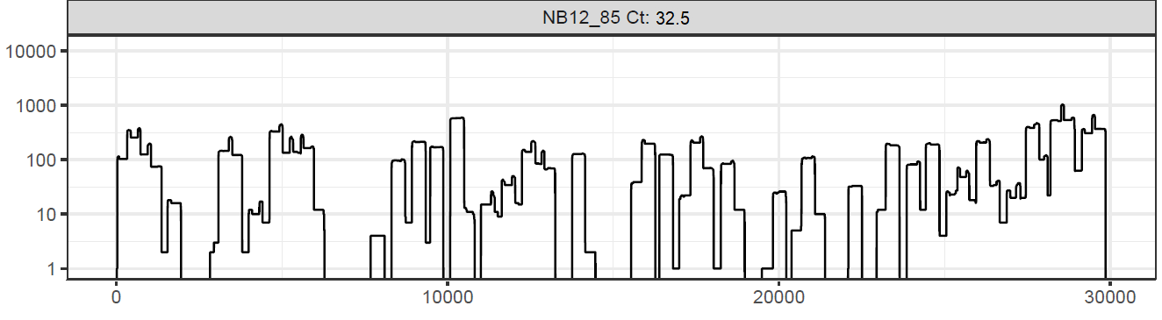
Genome Coverage vs Ct
High Ct sample – many amplicon dropouts and very low coverage profile:
less than 50% genome coverage

Slide 11
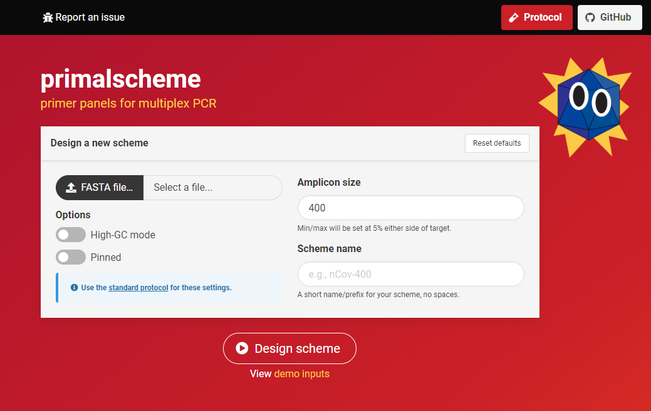
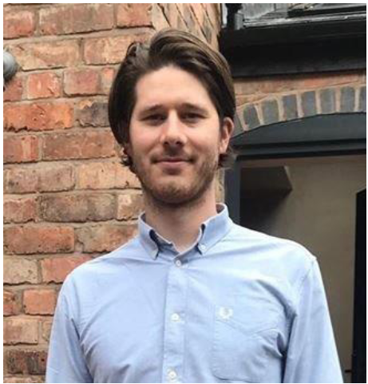
Artic protocol based on direct amplification of the virus using tiling primers approach for multiplex PCR.
Dr Josh Quick
University of Birmingham
https://primalscheme.com/
press and design your scheme
Notes:
For this purpose, the specific primer set the whole genome sequencing was created using PrimalScheme tool that was developed by Josh Quick and his colleagues from Uni of Birmingham.
As input, Primal Scheme requires a FASTA file containing one or more reference genomes. Then you specify a desired PCR amplicon length (i.e., 400 nt)

Slide 12
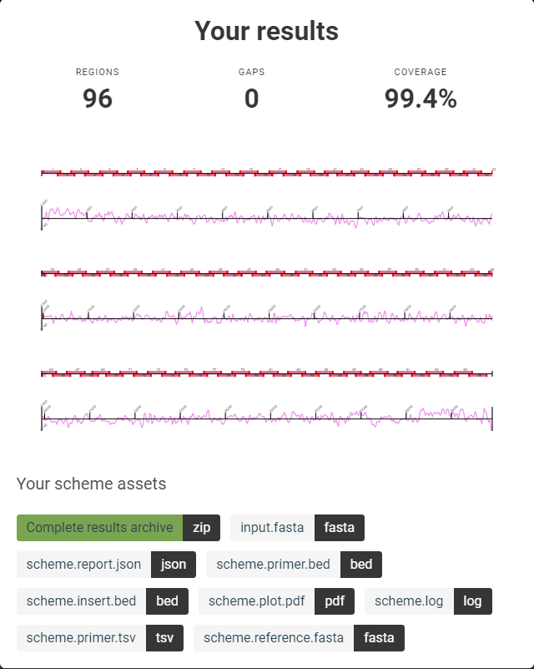
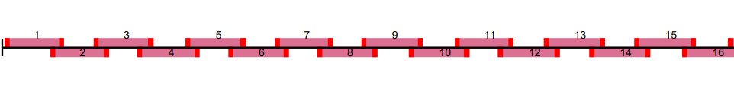
ARTIC for Real-time COVID Genomic Surveillance Primer Scheme for SARS-CoV-2 whole genome sequencing
tiling amplicon approach
Notes:
Output files include a table of primer sequences to be ordered, a BED file of primer locations that can be used for primer trimming during your assembly step and a diagram of the primer scheme.
Using a shorter amplicon length may be useful for samples in which longer products fail to amplify (e.g., when the virus nucleic acid is highly degraded)

Slide 13

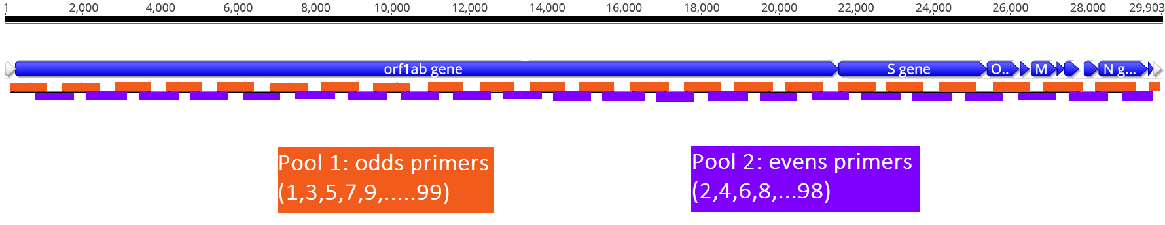
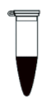
ARTIC for Real-time COVID Genomic Surveillance Primer Scheme for SARS-CoV-2 whole genome sequencing
Amplification of cDNA covering the whole genome in two reactions (with pool 1 & pool 2 primer sets)
so that neighboring amplicons do not overlap within the same pool
29,903bp genome size
In total 104 primer pairs (400bp amplicon size) to cover the whole genome
Notes:
this figure shows the regions amplified in pools 1 (orange) and 2 (purple), and the intended overlap between pools
allows amplification to cover the whole genome in two reactions

Slide 14

ARTIC for Real-time COVID Genomic Surveillance SARS-CoV-2 Primer Scheme Updates:
v1
v2
v3
v4
v4.1
v5 ??? in future
the first scheme created in January 2020 (start point of the pandemic)
based on the v1 with some modifications
new scheme designed to avoid amplicon drop outs for Beta and Delta variants including checks for 3' stable heterodimers (Itokawa et al. 2020)
based on the v4 with updates for Omicron variant (current version)
Notes:
Why we need this updates? We want to be sure that our amplification as well as sequencing can catch a new variant. And not only catch but provide high quality genomic data to be analised in the further analysis such phylogenetics, lineage assignment.
Some genomic regions are more variable than others (identify variants; mask known variant positions in ref genome; design primers; select best design (vary lengths, overlaps); additional primers as necessary.
There are specific sites in the genome where we can see increasing amplicon drop-out.
v4 - This primer scheme is not based on V3 but a new scheme designed to avoid high frequency variants in Alpha, Beta, Gamma, Delta
v4.1 - This primer scheme is an update to the V4 scheme which restores the functionality of some primers against the Omicron variant.

Slide 15
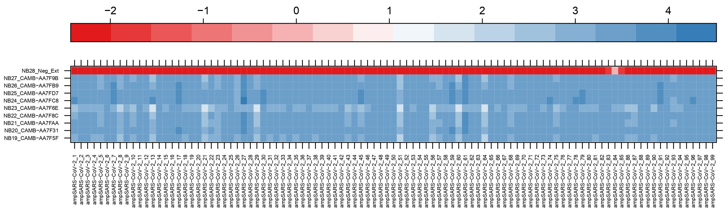
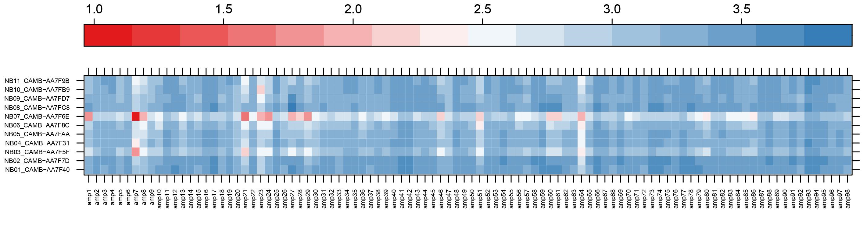
ARTIC for Real-time COVID Genomic Surveillance SARS-CoV-2 Primer Scheme Updates:
11 Delta samples
Primer Scheme Version 4
Primer Scheme Version 3
Notes:
v4 - new scheme designed to avoid amplicon drop outs for Delta variant
..approved the quality of the sequences

Slide 16
ARTIC for Real-time COVID Genomic Surveillance SARS-CoV-2 Primer Scheme Updates:
11 Delta samples
Primers Updates – to keep your sequences on high quality!

Slide 17

ARTIC for Real-time COVID Genomic Surveillance SARS-CoV-2 Primer Scheme Updates:
Thank you Josh Quick and all Birmingham Team!
Notes:
v4.1 - based on the v4 with updates for Omicron variant (current version)
increase genome quality – coverage.

Slide 18
ARTIC for Real-time COVID Genomic Surveillance SARS-CoV-2 Primer Scheme:
Primer sets for you:
V4.1 (Pool 1 and Pool 2) – stocks 100µM (for 1000 reactions)
Before to use: prepare working solution – 10µM:
Dilute 100 micromolar (µM) pools 1:10 in molecular grade water, to generate 10 micromolar (µM) primer stocks.
i.e., 20 ul of stock solution (100 uM) + 180ul of NFW = 200 ul working solution
Make up multiple 200 µL aliquots of 10µM primer dilutions and freeze (-20°C) them in case of degradation or contamination.
Finally: primers are used at a final concentration of 15 nanomolar (nM) per primer.
In this case V4.1 pools have 105 primers in pool 1 and 104 primers in pool 2 (total 209 primers)

Slide 19
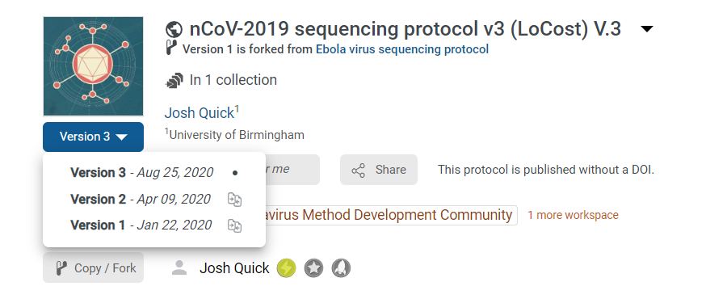

ARTIC for Real-time COVID Genomic Surveillance nCoV-2019 Seq protocol versions:
Multiplex PCR method for MinION sequencing of whole SARS-CoV-2 genomes directly from clinical samples
Important Changes in the v3(LoCost):
up to 96 samples per run
substitution RT Mix – easier and faster to use
reaction volume reduced to 10 µL
sequencing cost reduction with 96 barcodes
Notes:
nCoV-2019 Artic Protocol Advantages:
Cost and time
Easy to use
Portability and minimal lab equipment (lab-in-a-suitcase)
Changes in this version:
-Up to 95 samples per run with EXP-NBD196 native barcode kit
-Substitution of SuperScript IV for LunaScript RT SuperMix and reaction volume reduced to 10 uL.
-Substitution of Ultra II Ligation Module for Blunt/TA Ligase Master Mix and reaction volume reduced to 10 µL.
-Native barcode ligation reaction volume reduced to 10 uL.
-SFB wash volume reduced.

Slide 20
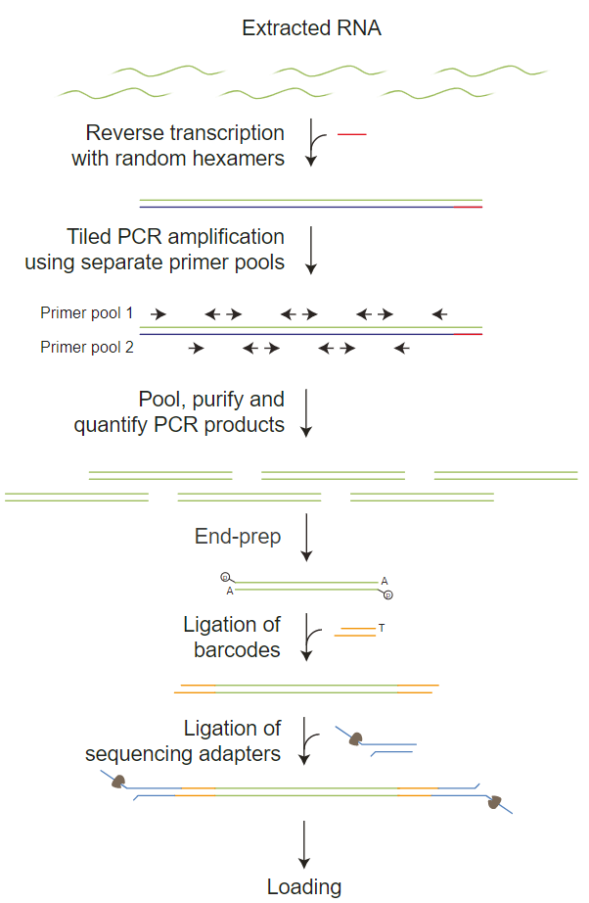
ARTIC for Real-time COVID Genomic Surveillance You will need to:
Samples
Prepare samples (RNA extraction, Ct); create Google Spreadsheets for sample validation and data and metadata curation
Multiplex RTPCR
Reverse transcribe your RNA samples with random hexamers
Enrich the samples with Primer Scheme primer sets
Amplicon Quantification
Combine the primer pools, purify and quantify the PCR products
EndPrep
Prepare the amplicon ends for barcode attachment
Barcoding
tag your samples with individual barcode (1 – 96 barcodes) to sequence them as one batch on one Flow Cell
Adaptor Ligation
pool your barcoded samples, clean them up and tag with specific adapter which guide your amplicons how to find nanopores and be sequenced
Prime the flow cell and load your library into a Flow Cell
Notes:
This approach has been proven to have high sensitivity and work directly from clinical samples (compared to metagenomics approaches). This protocol has been widely adopted by groups worldwide

Slide 21
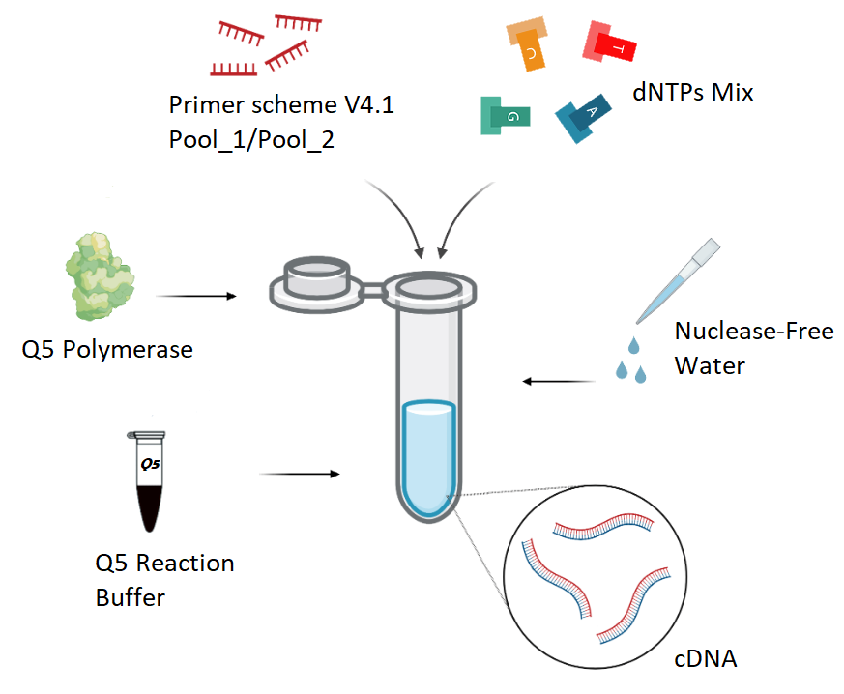
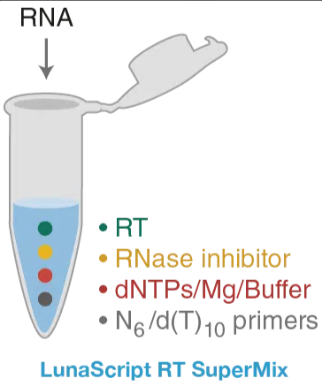
ARTIC for Real-time COVID Genomic Surveillance RT-PCR genome enrichment:
You will need:
YOU!
your RNA
some reagents
some equipment
2) Step 1: PCR ~4 hours
1) Step 1: RT ~20 mins
cDNA

Slide 22
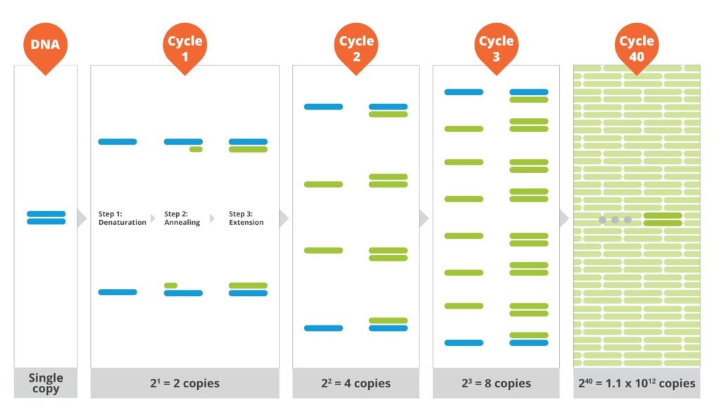
ARTIC for Real-time COVID Genomic Surveillance RT-PCR genome enrichment:
enough to cover the whole genome, isn’t it?
from https://lexagene.com

Slide 23
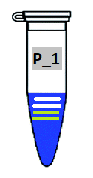
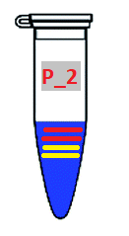

ARTIC for Real-time COVID Genomic Surveillance RT-PCR genome enrichment:
after ~4 hours PCR
combine amplicons per sample
(pool 1 and pool 2) in one tube
+
Amplicon Clean Up with magnetic beads
Pool 1
Pool 2
Pooled amplicons for one sample
amplicon products (400bp) per sample
Notes:
Once PCR is complete
to obtain very even barcode representation and high barcode ligation efficiency improvements clean-up step is required.

Slide 24
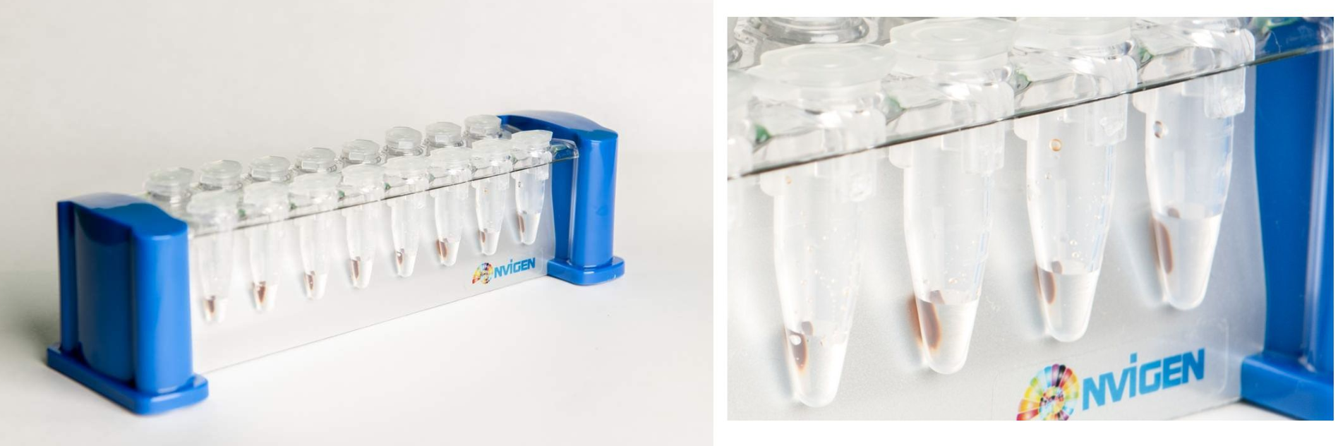
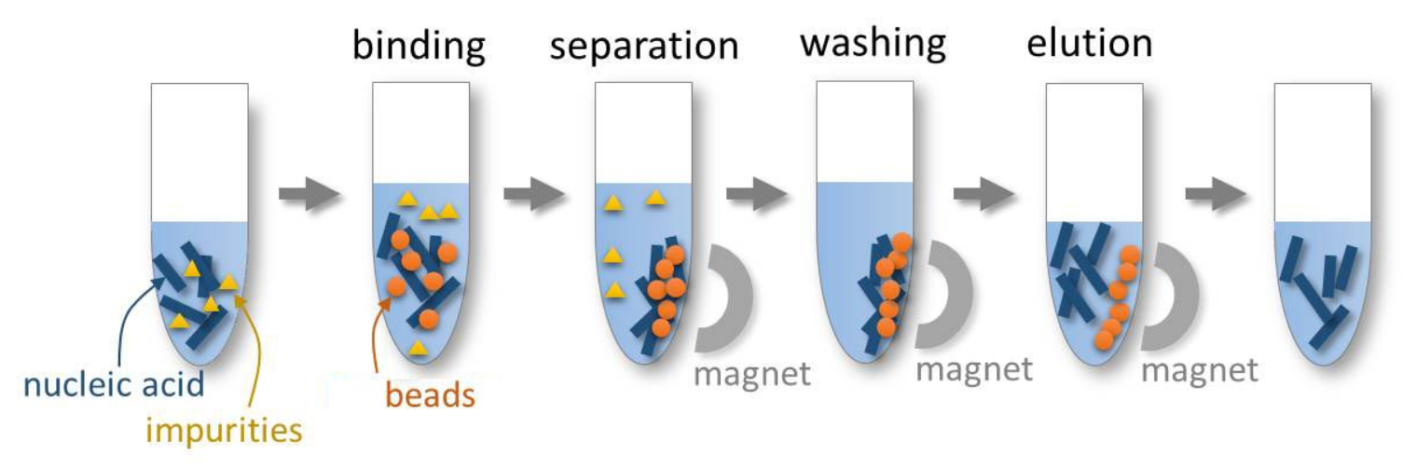
ARTIC for Real-time COVID Genomic Surveillance Amplicon Clean Up with magnetic beads:
You will need to:
wash out leftover reagents after the RT and PCR reactions, which affect your next steps of the library preparation!
figure source: https://biodynami.com
Notes:
each sample!
Solid Phase Reversible Immobilization (SPRI) is a technique applied in high-performance isolation, purification, and cleanup procedures. The process uses SPRI magnetic beads by selectively binding nucleic acids

Slide 25
ARTIC for Real-time COVID Genomic Surveillance Post PCR QC:
You will need to:
measure your amplicon post-clean up concentration with Qubit
record the results in your Google Spreadsheet for sample validation and data curation
normalize your sample set (exclude samples below 3ng/ul concentration)
run gel if your Negatives concentration values are high (commonly they should be < 0,1 ng/ul)
run gel if your samples show low concentration results to check the amplification efficiency (before and after the clean up step)
On this step IMPORTANT to check your Negative controls: Extraction Neg Control and Neg Control at the RT-PCR step
!!! Always track and monitor cross-contamination using nuclease-free water and carrying these controls through all library prep steps !!!

Slide 26
ARTIC for Real-time COVID Genomic Surveillance Post PCR QC:
Why should we exclude samples below 3ng/ul concentration to normalize samples before starting the next step?

Slide 27
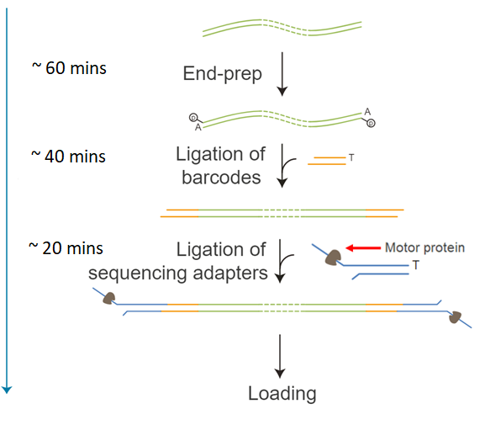
ARTIC for Real-time COVID Genomic Surveillance Library End-prep, Barcode & Adapter Ligation:
You will need to:
Prepare the amplicon ends for barcode attachment
Attach (ligate) barcodes supplied in the kit to the prepared amplicon ends
Pool barcoded samples into one tube – your library
Clean Up your library – wash out leftover reagents after the End-prep and Barcoding reactions, which affect your next step of the library preparation
Attach (ligate) sequencing adapters supplied in the kit to the barcoded amplicon ends
Final Clean Up – wash out leftover reagents after the Adapter Ligation reaction
Notes:
In a new strip-tube/plate set up the reaction for next End Prep Step for each sample

Slide 28
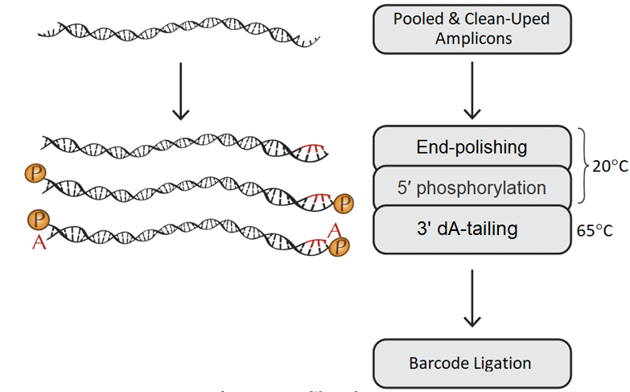
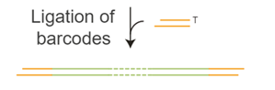
ARTIC for Real-time COVID Genomic Surveillance Library End-prep, Barcode & Adapter Ligation:
What does it mean- Prepare the amplicon ends?
Notes:
ready to use and optimized Enzyme Mix together with Reaction buffer to convert your amplicons to repaired fragments having 5′ phosphorylated and 3′ dA-tailed ends.
End-polishing – preparing blunted ends: it means remove 3’ overhangs and fill in 5’.
All ligations require a phosphate on the 5’ ends.
Add a single A (deoxyadenosine) to the 3’ ends – this tail will needed for barcode ligation.
Though you need few enzymes the end-prep reaction can be conduct in one tube. Because enzymes work at different temperature (while one active another one inactive).
they do not interfere with each other

Slide 29

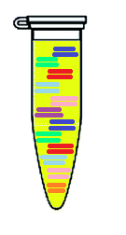
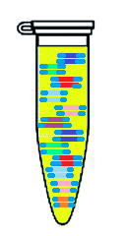
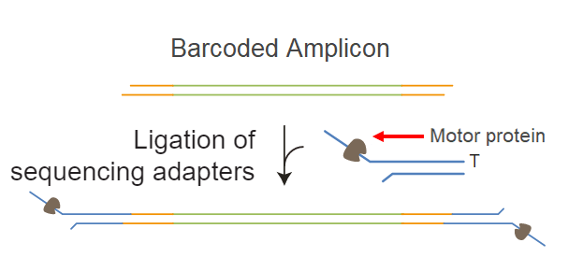
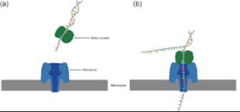
ARTIC for Real-time COVID Genomic Surveillance Final Library prep & QC:
Library – Pooled & Clean Upped barcoded amplicons
Final Library – barcoded amplicons with attached Adapters
Ethanol will kill the Motor Protein and your Amplicons never find pores to be sequenced!
Clean Up your Final library
(do not use ethanol!)
Qubit (concentration)
Qubit (concentration)
Final concentration should be 80ng/loading (or 6-7ng/ul)
≥30 ng total concentration is needed to achieve max yield!
Notes:
wash out free swimming barcodes and etc

Slide 30
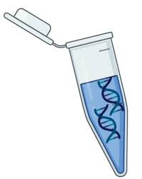


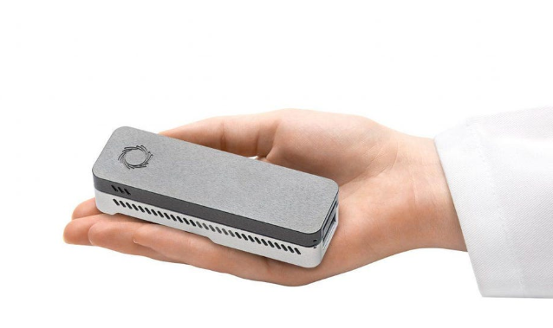
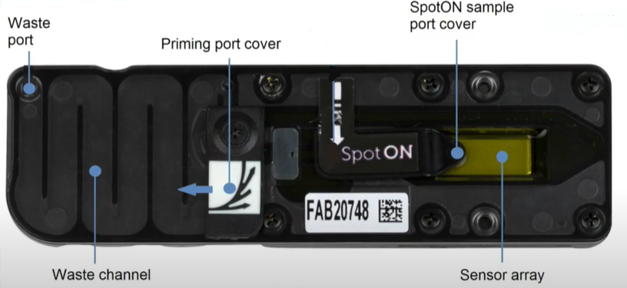
ARTIC for Real-time COVID Genomic Surveillance Loading Flow Cell & Start Sequencing:
3) your final Clean Upped Library (80ng)
You will need:
2) ONT Reagents to prepare your:
1) Laptop with installed MinKNOW, RAMPART
Priming Mix
Loading Mix for the library
5) MinION sequencing device
4) Flow Cell

Slide 31
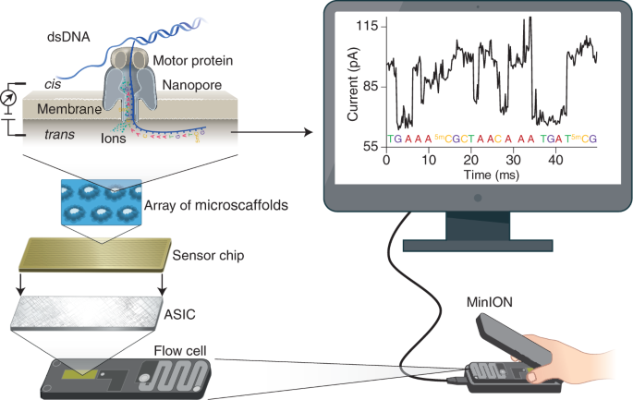
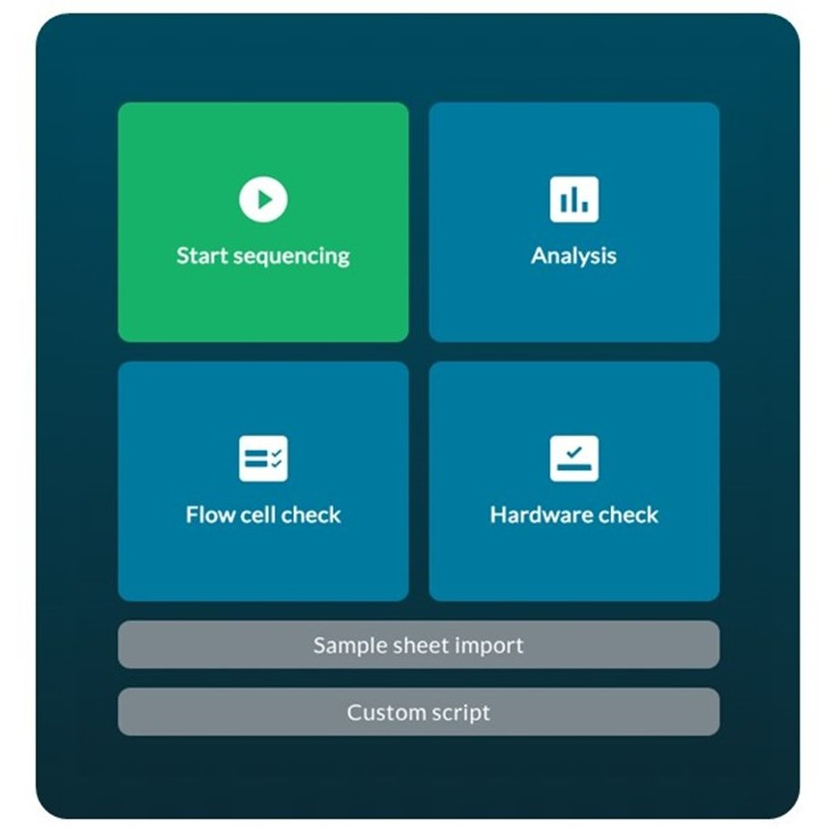
ARTIC for Real-time COVID Genomic Surveillance Loading Flow Cell & Start Sequencing:
The sequencing device control, data acquisition and real-time basecalling are carried out by the MinKNOW software
Open MinKNOW on your laptop
Start Sequencing experiment
Name the Run and set up sequencing settings
Wang, Y., et al. Nanopore sequencing technology, bioinformatics and applications. Nat Biotechnol 39, 1348–1365 (2021). https://doi.org/10.1038/s41587-021-01108-x
Notes:
Start a sequencing run using the MinKNOW software, which will collect raw data from the device and convert it into basecalled reads.
At the heart of the MinION device, an enzyme unwinds DNA, feeding one strand through a protein pore. The unique of each DNA base causes a characteristic disruption in electrical current providing a readout of the underlying sequence.

Slide 32
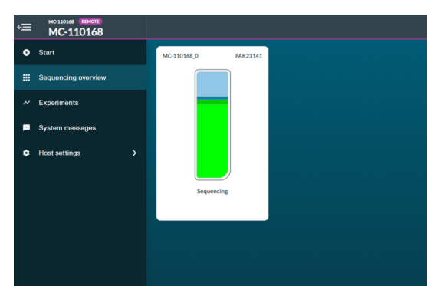
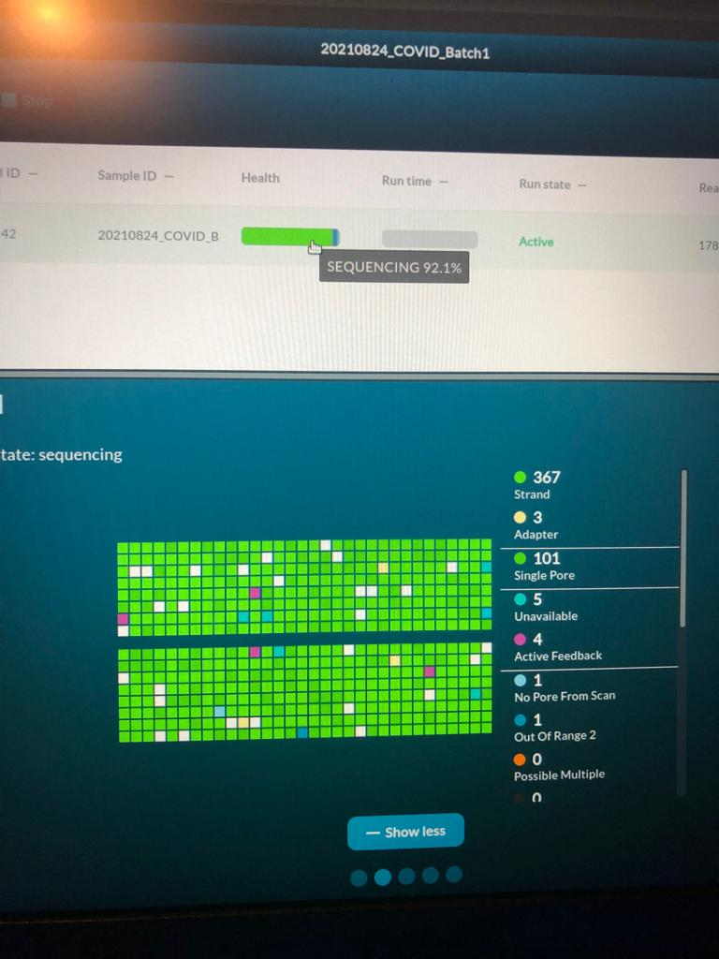
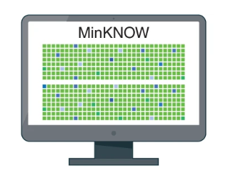

ARTIC for Real-time COVID Genomic Surveillance Loading Flow Cell & Start Sequencing:
more GREEN everywhere!!!

Slide 33
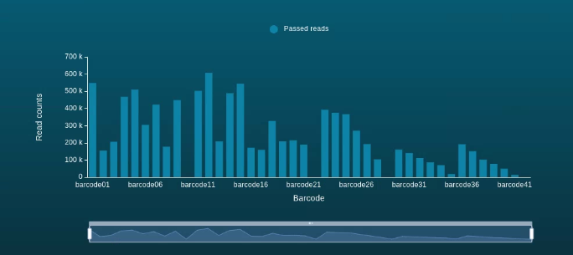

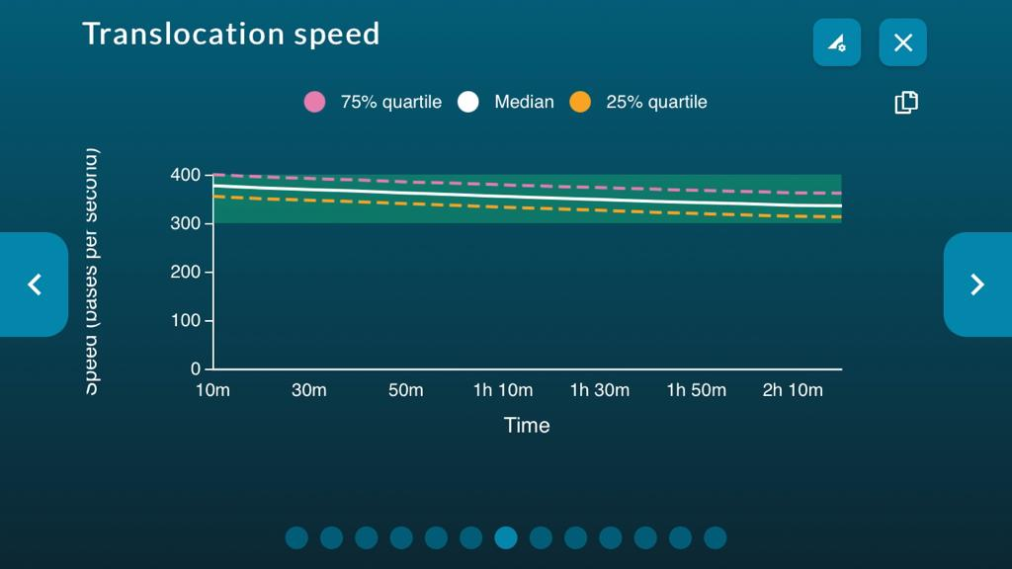
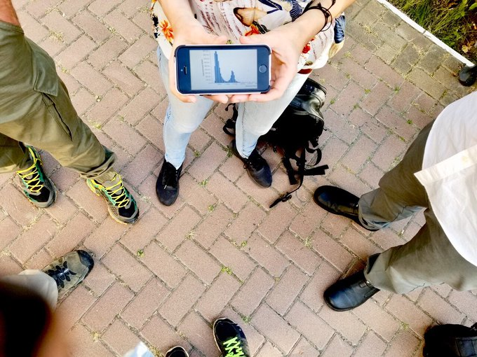
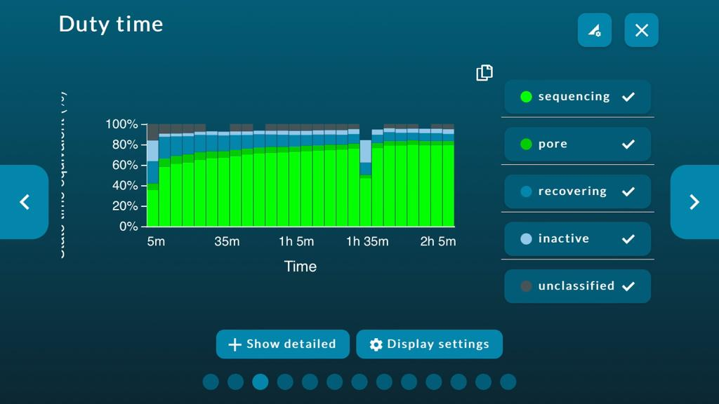
ARTIC for Real-time COVID Genomic Surveillance Loading Flow Cell & Start Sequencing:
Barcode hits
Relax and monitor your run in real-time:
MinKNOW App for iOS and Android, available in Apple Store and Google Play.
Happy @nanopore moment in Ukraine cheering around a shot of the remote tracking of our 12th run on our way to pub ☺

Slide 34
ARTIC for Real-time COVID Genomic Surveillance ARTIC nCoV-2019 sequencing protocol:
RT
PCR
Barcode Ligation
Pooling, Clean Up & Adapter Ligation
Amplicon Pooling & SPRI Cleanup
End Prep
Priming Loading Flow Cell
Sequencing
Timeline of nCoV-2019 Artic Sequencing Protocol
30 mins
4.5 hours
1 hour
1.5 hours
1 hour
1 hour
15 mins
1 day
Library Preparation
9 hours 45 mins

Slide 35

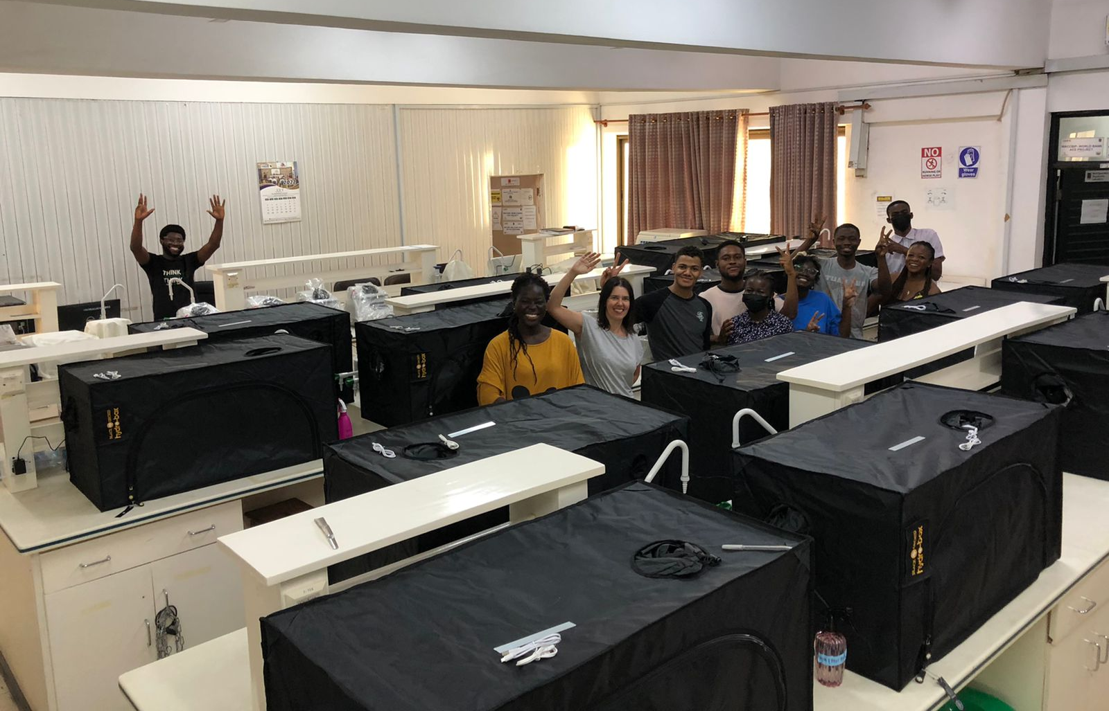

Let’s go to sequence ….

Slide 36



